Slide 1


Slide 2
CLIMATE CHANGE
A massive global problem which everyone can help solve – SMALL CHANGES, BIG IMPACT
Think Global, act Local

Slide 3
CCAG OBJECTIVES
Better understand policy changes as they relate to our community
Get residents to understand their own carbon footprint
Be a voice for local residents on issues such as recycling, car use etc
Act as a forum to influence local NYC policies that affect our community
Liaise with other local groups and citizens on zero carbon
To act with local residents to develop a ‘net zero plan’

Slide 4
COMMUNITY CLIMATE ACTION GROUP – CURRENT MEMBERS
Eilis Burrows
Nigel Davies
Colin Garner
Philip Orton
Mark Shepherd
George Winn-Darley
Andy Yates
IF YOU ARE INTERESTED IN JOINING OUR COMMITTEE PLEASE CONTACT US

Slide 5
TOWARDS ZERO CARBON
By working together we will be much more effective
than working individually

Slide 6


Slide 8
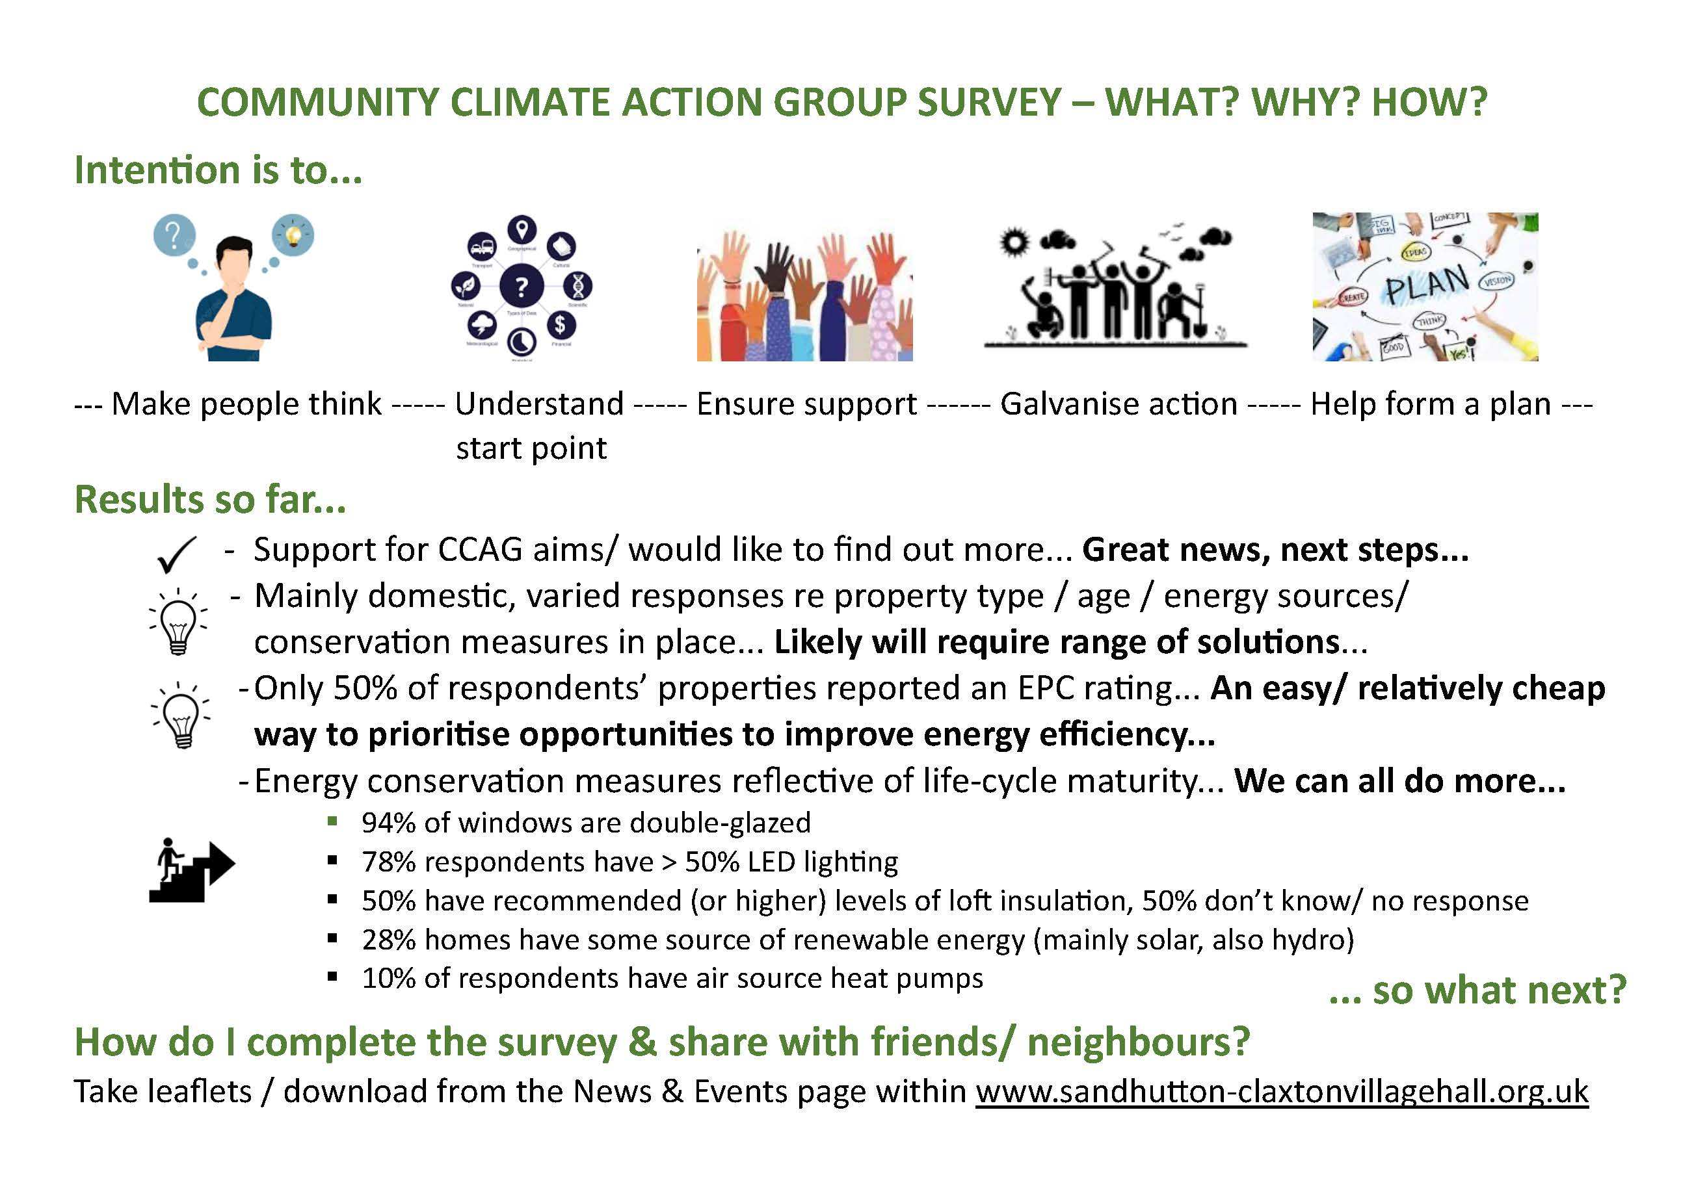

Slide 9
