Slide 1
Using the FLIR 6 Thermal Image Camera
Sand Hutton and Claxton Village Hall
Saturday 24th February 2024
Philip Orton

Slide 2
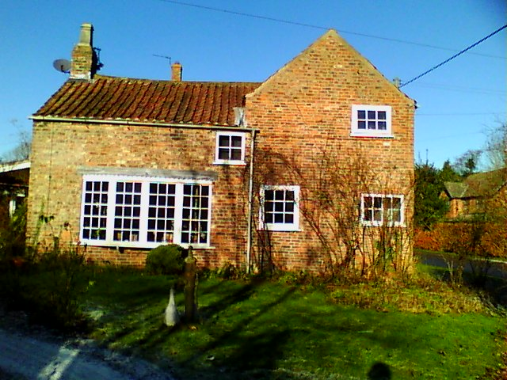
Surveying Manor House –built pre 1900

Slide 3
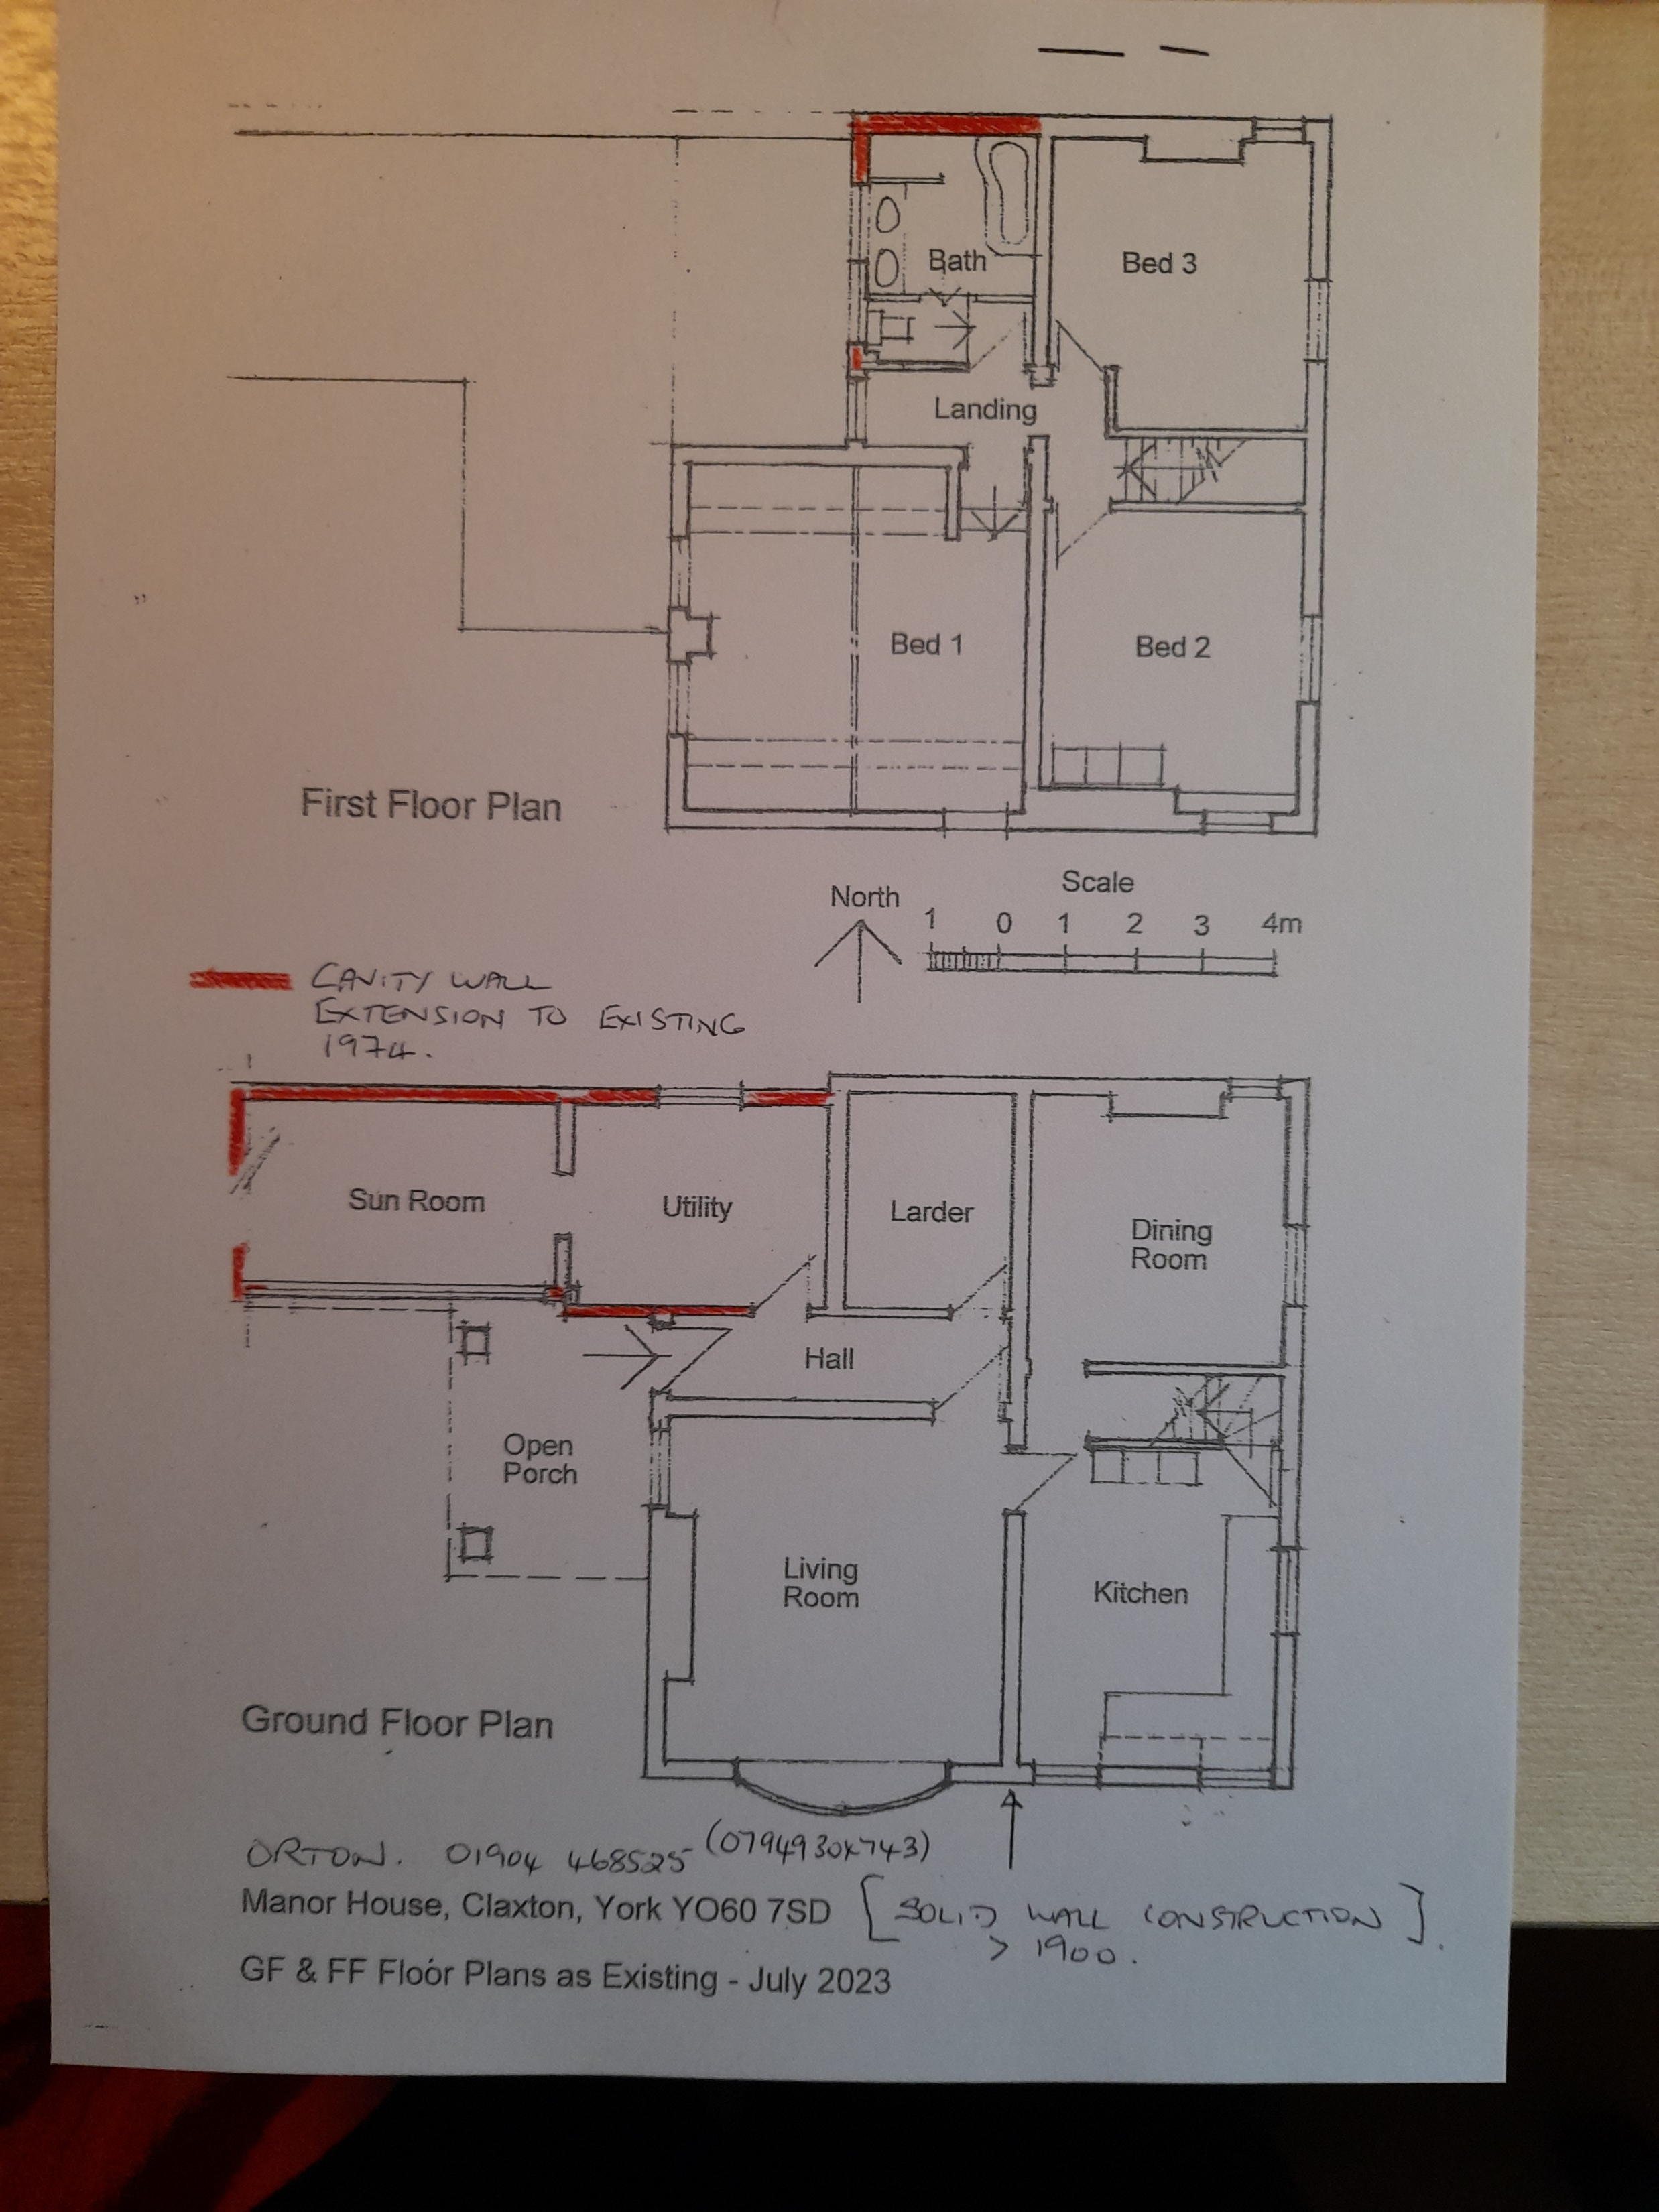
Mainly solid wall- extension has a cavity wall(red)
Energy Performance Certificate (EPC) E 50 points

Slide 4
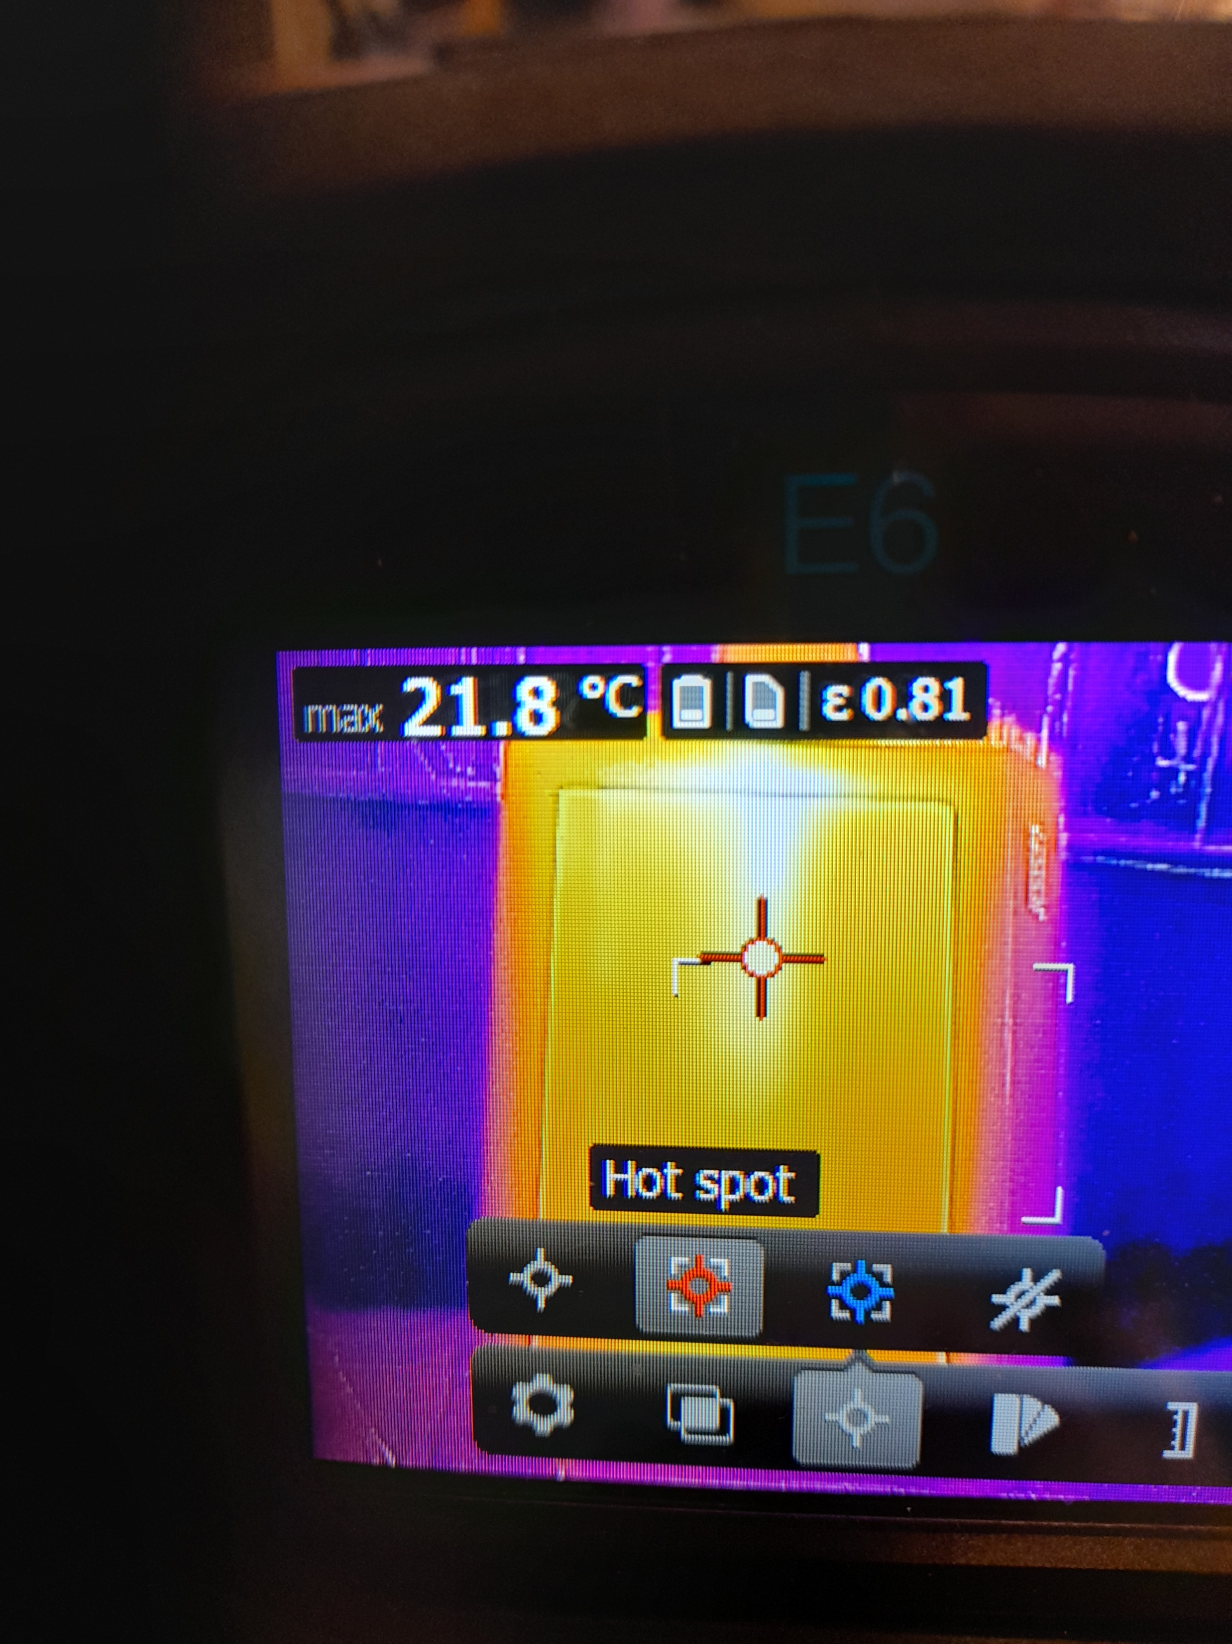
Selecting the camera Hot spot function to detect external heat loss………

Slide 5
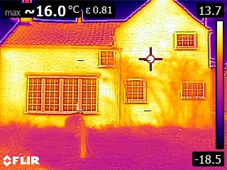
Bright spots indicate heat loss.......

Slide 6
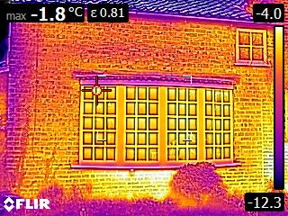
There is noticeable heat loss under bay window…..

Slide 7
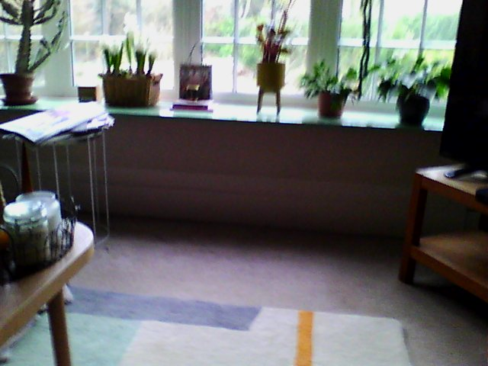
Moving inside to bay window….

Slide 8
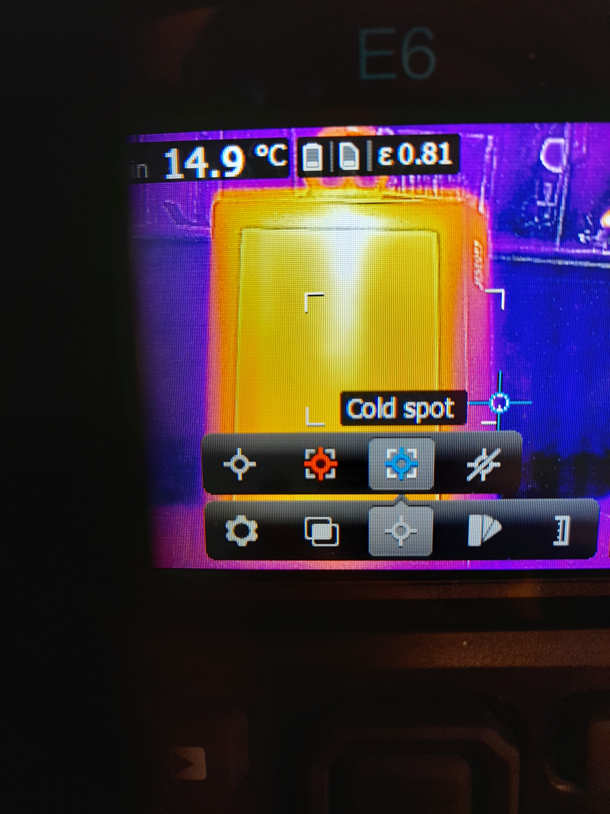
And changing camera setting to detect Cold spot…

Slide 9
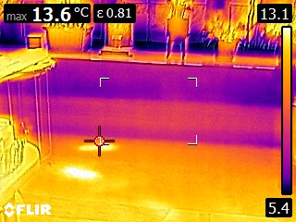
-shows corresponding cold zone under window …..

Slide 10
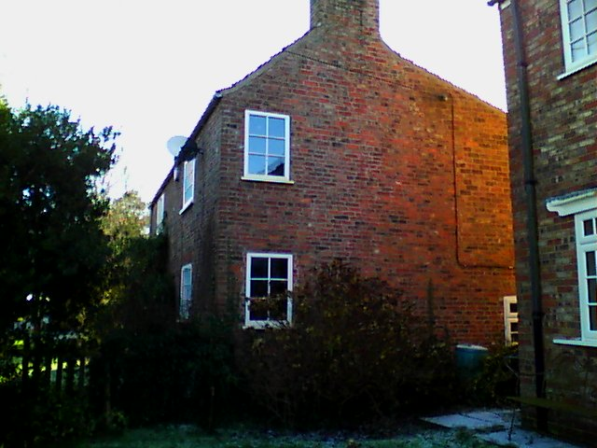
The house north wall, which gets little sun; the 1973 extension is to the right….a cold wall

Slide 11
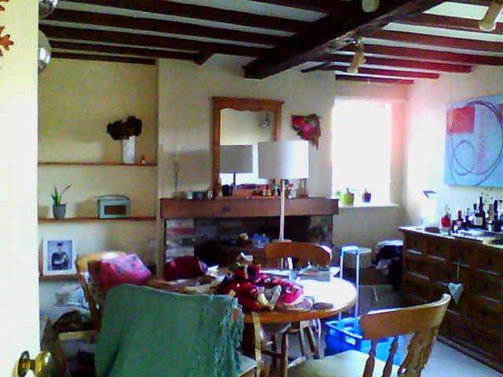
Inside this north wall is a dining room.. with inset left and right alcoves…

Slide 12
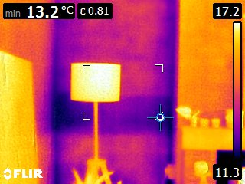
- alcove walls show up as a cold spot……

Slide 13
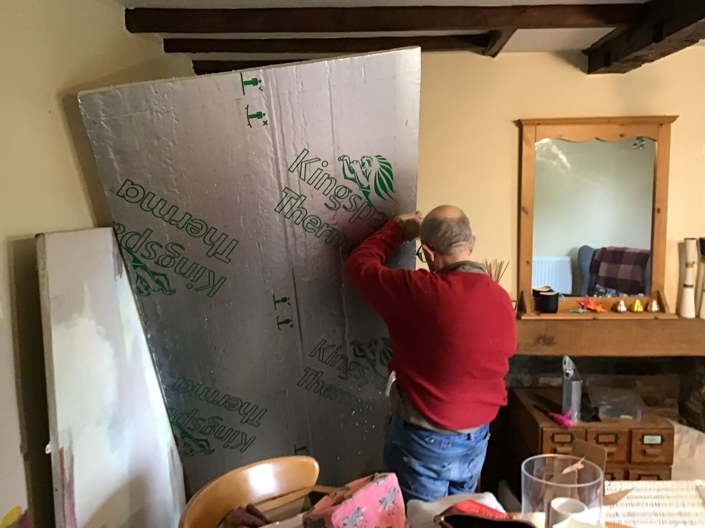
- an insulation job beckons……!

Slide 14
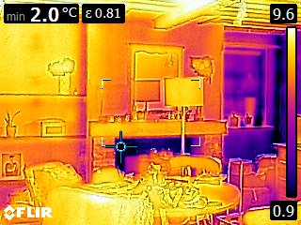
Success!- reduced heat loss from insulated left alcove compared to uninsulated on the right…

Slide 15
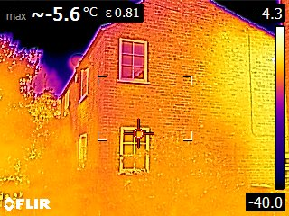
Outside again, the right hand north wall extension shows a hot spot …

Slide 16
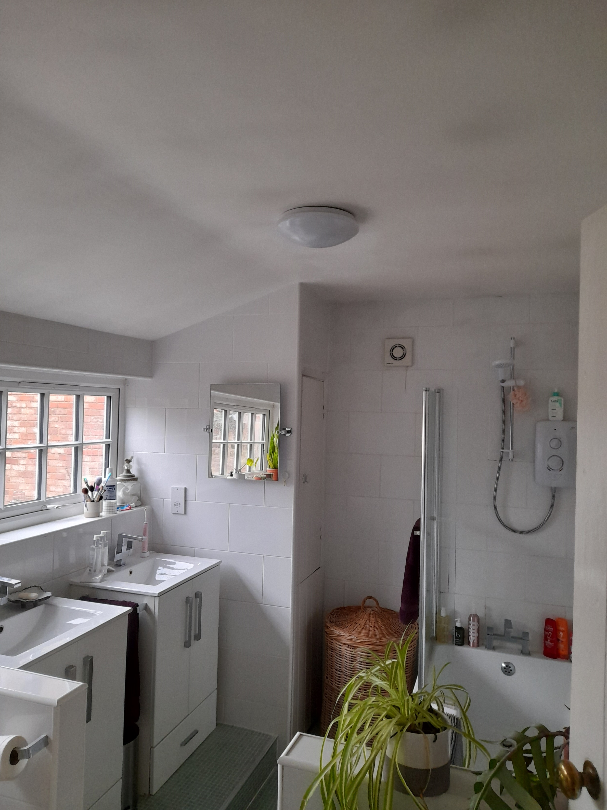
-this contains the bathroom, which seems to have some condensation patches on the ceiling…..

Slide 17
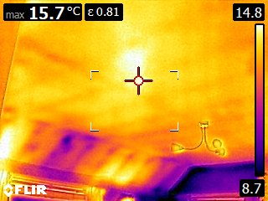
with associated cold spots……..

Slide 18
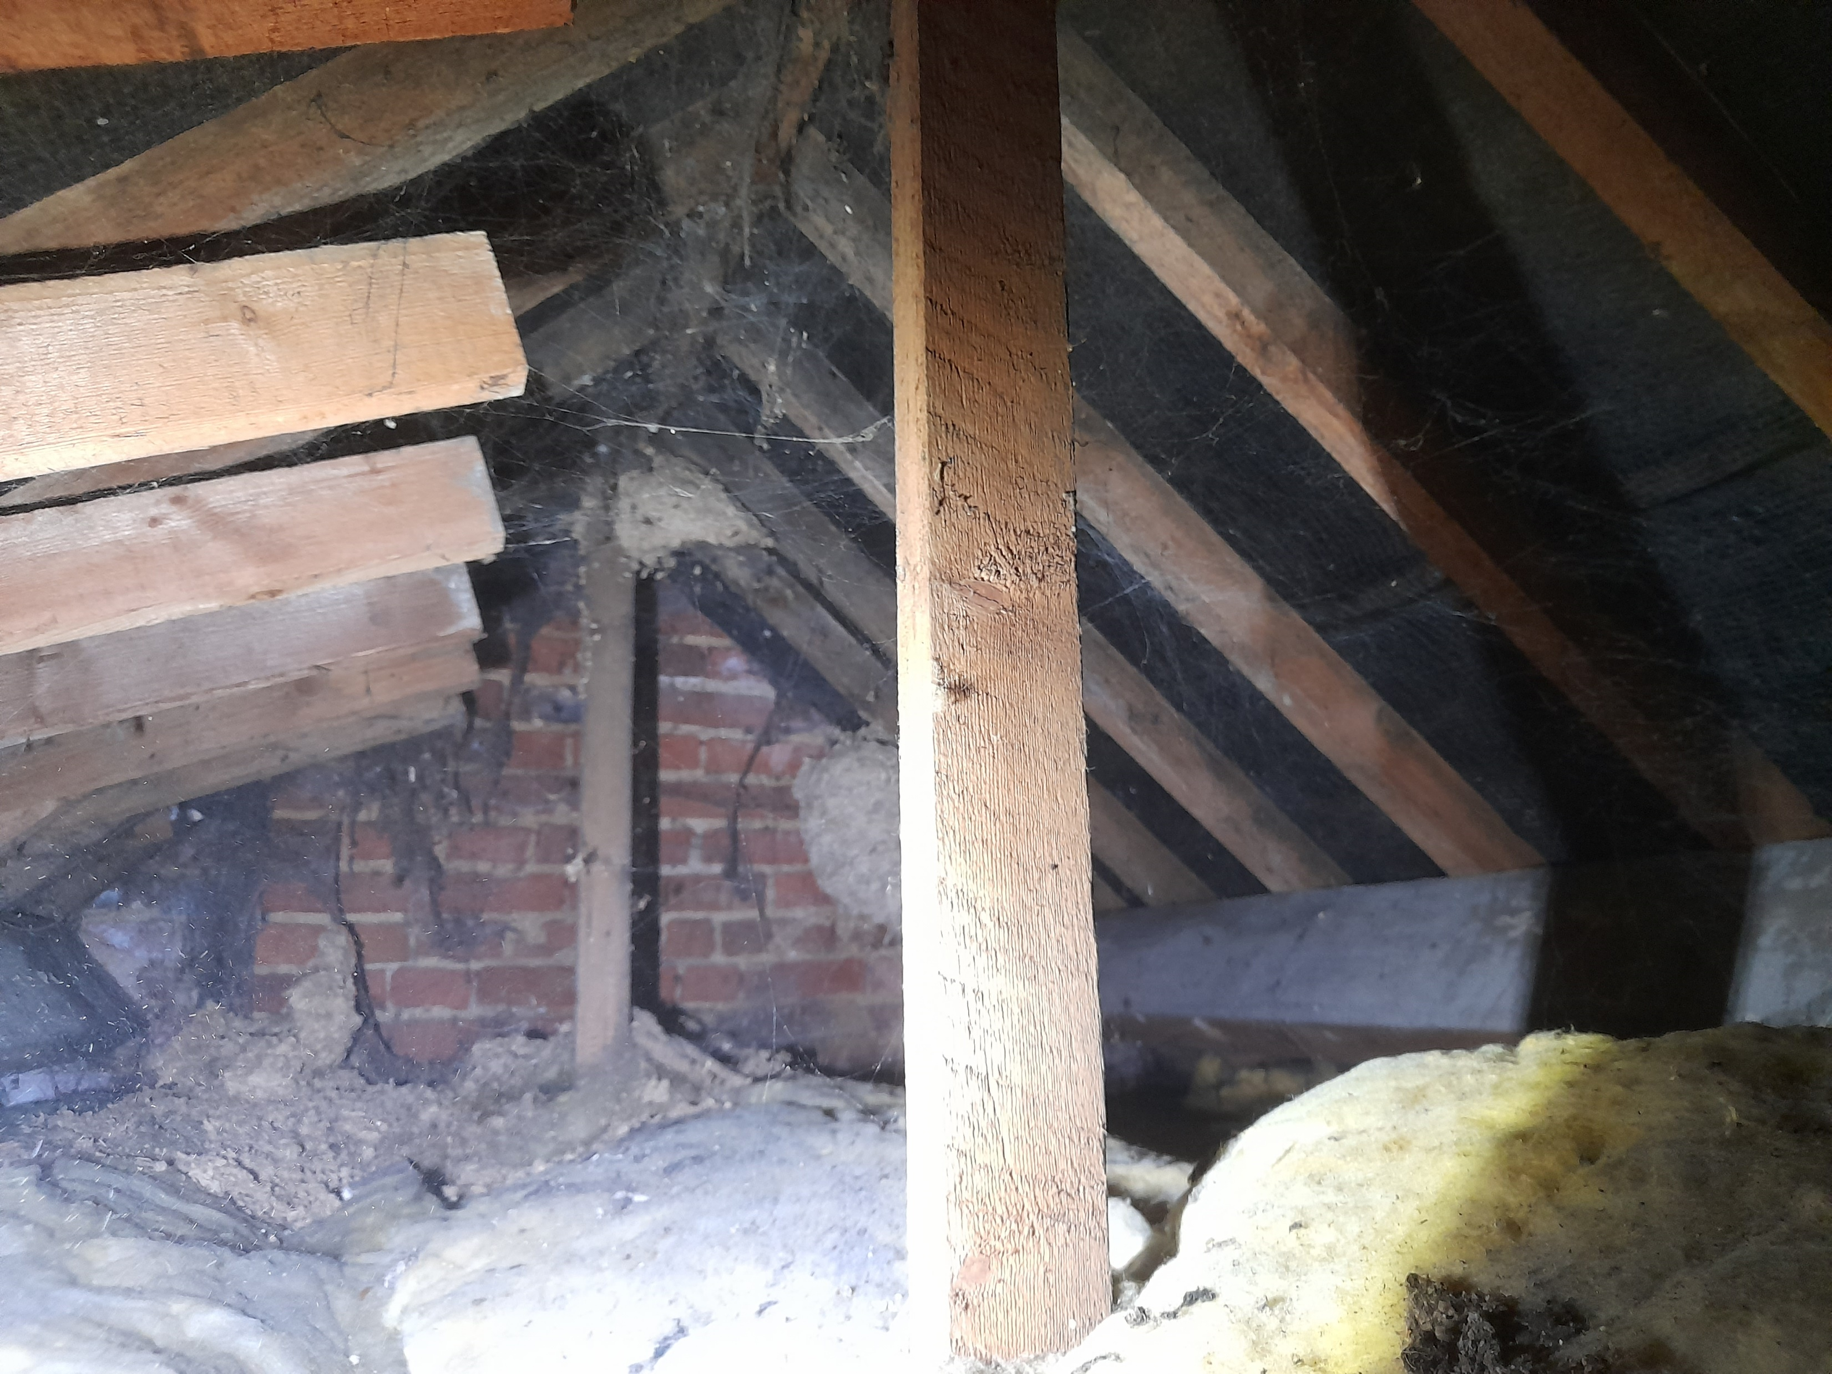
There is little insulation in the ceiling space here….

Slide 19
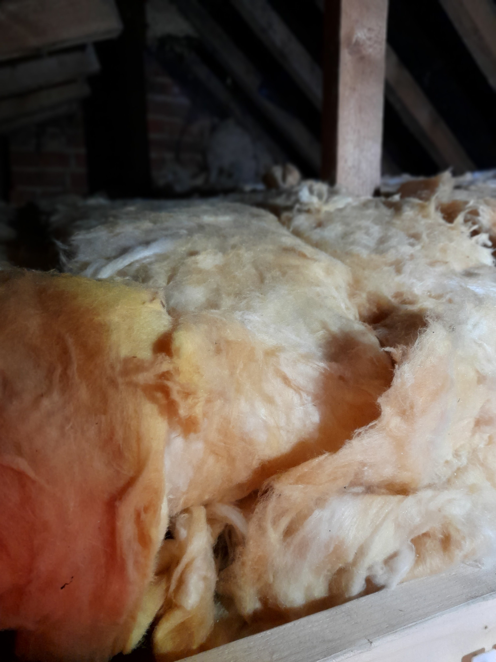
- which has been improved to current standards…….

Slide 20
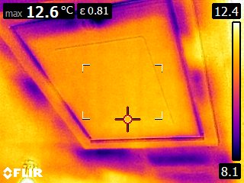
-but there are still some problems with loft hatch drafts…

Slide 21
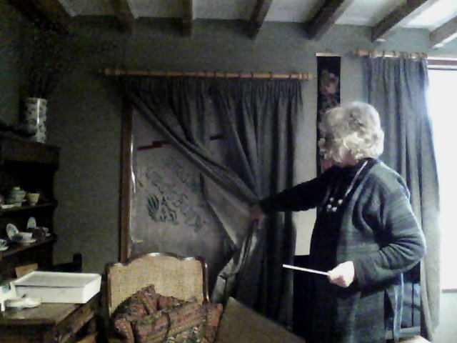
Rolling out the camera to the community
Anne shows off her door insulation……….

Slide 22
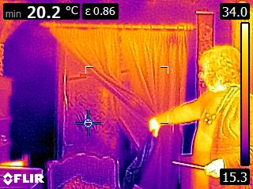
The thermal image shows the benefit of the insulation and the covering curtain…..

Slide 23
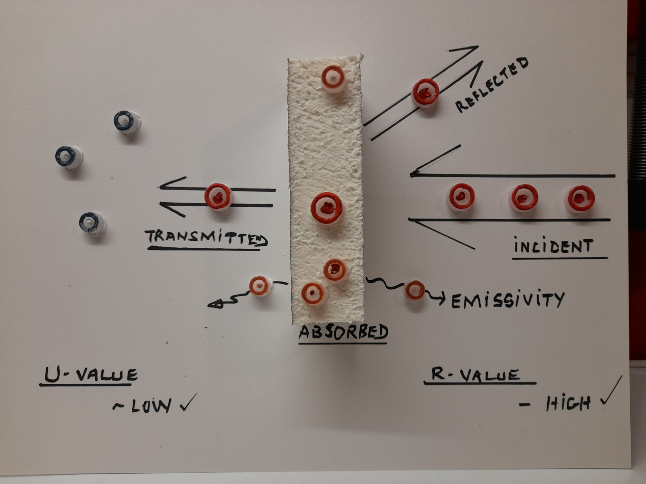
A little of the science behind thermography..

