Slide 1
Climate Change Strategy
Community Decarbonisation
Adam R. Vaughan Climate Change Business Partner (Resource)
OFFICIAL

Slide 2
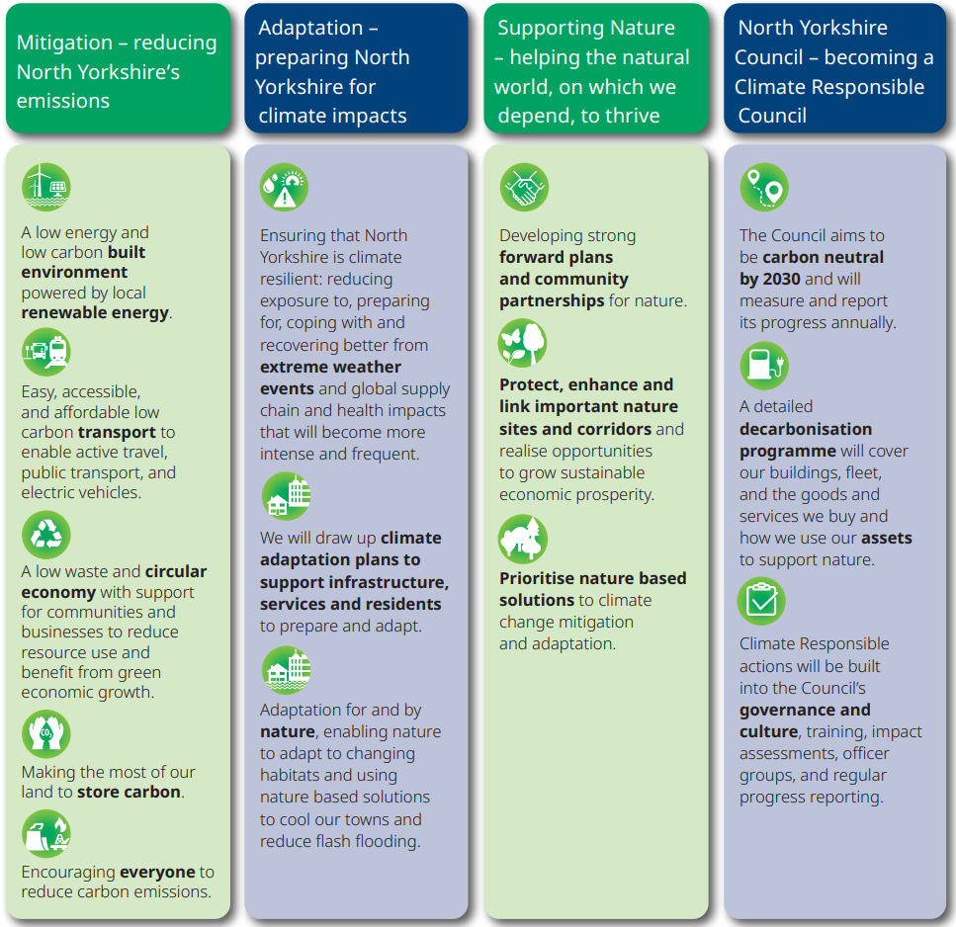
2023 - 2030 Plan
NYC climate responsible council: aiming to be carbon neutral by 2030
Slowing further change
Adapting to climate
Supporting natural recovery

Slide 3
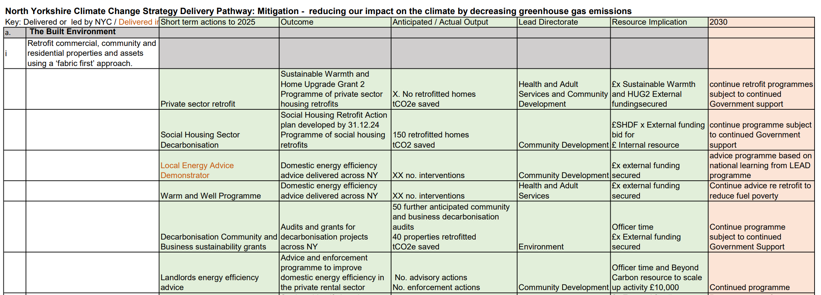
Delivery Pathway (Strategy Action Plan)
Draft Delivery Path (NYC TEEEOSC, Feb 24)
Planning Community Environment Workshop
Draft Directorate Action Plans (Mar 24)
Governance – 18 actions
Mitigation - 55 actions
Supporting Nature – 22 actions
Adaptation - In developed

Slide 4
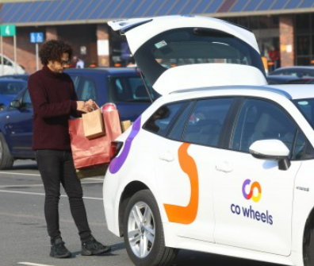
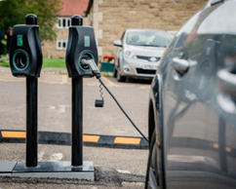
Car Club scheme
Environmental Grants
Shared Prosperity Fund
Domestic Retrofit
Electric Vehicle Charging Points
HUG2
LEVI £5.4m

Slide 5
Delivery Pathway
Built Environment
Retrofit commercial, community and residential properties and assets using a ‘fabric first’ approach.
Short term actions (2025) | Outcome | Anticipated / Actual Output | 2030
Decarbonisation Community and Business sustainability grants | Audits and grants for decarbonisation projects across NY | 50 further community/business decarbonisation audits 40 properties retrofitted tn CO₂e saved | Continue programme subject to continued Government Support
Develop community energy programme | Supporting locally based retrofit programmes | Support for community energy efficiency projects Pickering Geothermal Well study | To support implementation, share the learning and replicate
HUG2 – Domestic property retrofit
Shared Prosperity Fund Decarbonisation Scheme

Slide 6
Delivery Pathway
Travel and Transport
Short term actions (2025) | Outcome | Anticipated / Actual Output | 2030
Support public transport development and modal shift Consolidate and expand 'Car Share' Schemes, internal and external | Local Transport Plan (LTP) Increased use of NYC supported public transport Public transport infrastructure improvements (place making) Increased membership of joint car use schemes (car clubs) Investigate options for expanding scope, encourage take up of car share opportunities Continuation of North Yorkshire Lift Share programme | Local Transport Plan Quantifiable Carbon Reduction No. Public transport infrastructure improvements No. journeys on NYC supported public transport Harrogate car share scheme: No. miles saved No. community shared mobility schemes (tn CO₂e saved) | LTP implementation Continue programme subject to continued Government Support and / or financial business case development
Enable and support people to choose multi person travel options

Slide 7
Delivery Pathway
Travel and Transport
Short term actions (2025) | Outcome | Anticipated / Actual Output | 2030
Support community and business conversion to low carbon fuels | Enabling low carbon fleet options NYC EVCP Strategy roll out Feasibility study on production and use of green hydrogen for HGV fleet. SPF Decarbonisation programme for communities and businesses Regional Hydrogen supply and demand study by NE&YNZH | km converted to EV km converted to green hydrogen Km converted to alternative fuels. tn CO₂e saved | Continue programme subject to continued Government Support and / or financial business case development
H₂
Increase access to ‘alternative fuels’ for personal and commercial vehicles
Local Electric Vehicle Infrastructure (LEVI) – Pilot
On-street charge point - locations

Slide 8
Delivery Pathway
Waste and Circular Economy
Renewable Energy Transition
Support delivery of the York and North Yorkshire Circular
Short term actions (2025) | Outcome | Anticipated / Actual Output | 2030
Support communities and businesses to adopt circular economy | Procurement strategy refresh Economic Development Strategy SPF business and community grant programme. | No. circular economy actions | Monitor circular economy strategy implementation
Programme of renewable energy development and utilisation | Increase in renewable energy generation and storage SPF Business and Community decarbonisation grants programme Feasibility study into harbour based renewable energy and AWRP green energy production Support for schools sector to generation and utilise renewable energy | kwh renewable energy generation No. projects supported Feasibility study completed NYC energy usage | Continue programme subject to continued Government Support and/or financial business case development
Increase renewable and low carbon energy capacity at differing scales

Slide 9
Shared Prosperity Fund
UKSPF@yorknorthyorks-ca.gov.uk
OFFICIAL

Slide 10
Routemap to Carbon Negative
York & North Yorkshire pathway
Range of Community interventions/actions:
Energy Efficiency
Retrofit
Transport
Renewable Energy
Community woodland
Natural recovery

Slide 11
Thank You

